Slide 1

Visual-RFT: Visual Reinforcement Fine-Tuning
Philipp Rössel
Vision-Language Models in Medical Imaging
11.06.2025

Slide 2
What is the paper about ?
Method for fine-tuning VLMs using reinforcement learning instead of supervised learning
Introduction of verifiable reward functions for visual perception tasks like:
Image classification
Few-shot object detection
Open-vocabulary object detection
Evaluation of model trained with Visual-RFT
Comparison to a baseline model trained with supervised fine-tuning (SFT)

Slide 3
Why is it relevant ?
With SFT a model learns to imitate ground truth answers
Requires large amounts of high-quality curated data
RFT evaluates a model’s answers and adjusts based on their correctness
RFT requires significantly less data because model can learn by trial and error
So far RFT was mainly used for tasks like mathematical problems and coding
Visual-RFT enables new task domains

Slide 4
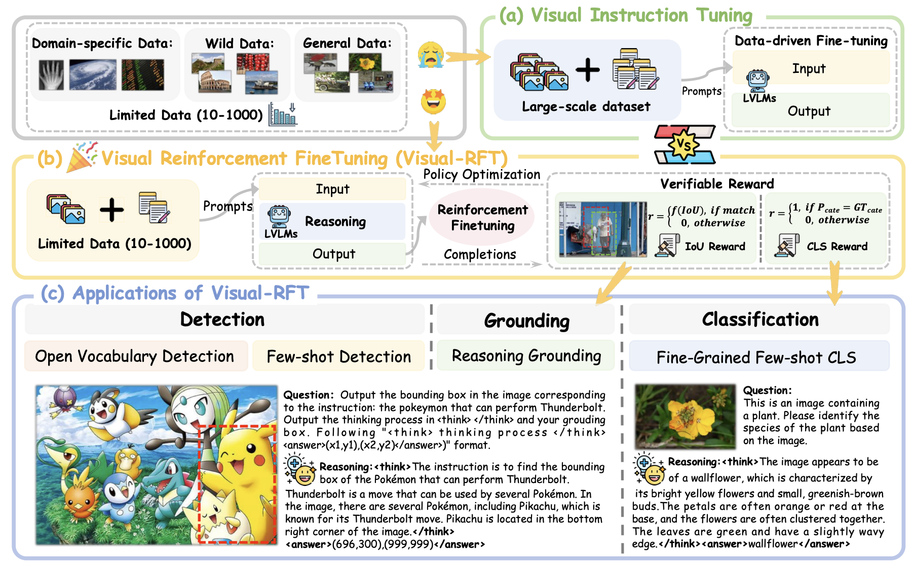
Visual Instruction Tuning vs. Visual-RFT

Slide 5
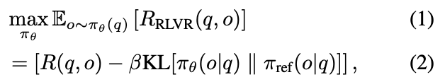
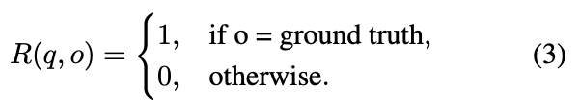
Reinforcement Learning with Verifiable Rewards
Novel approach originally designed to enhance language models in tasks with objectively verifiable outcomes
Does not require a trained reward model like RLHF
Instead uses a direct verification function to assess correctness

Slide 6
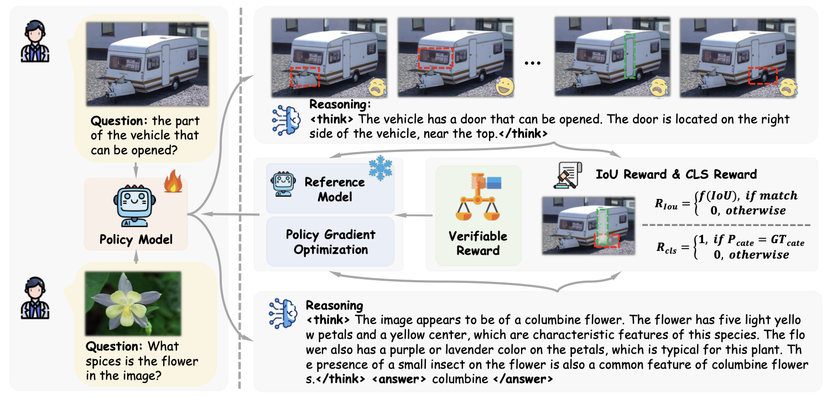
Visual-RFT Framework

Slide 7
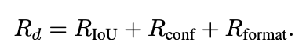
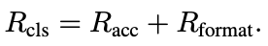
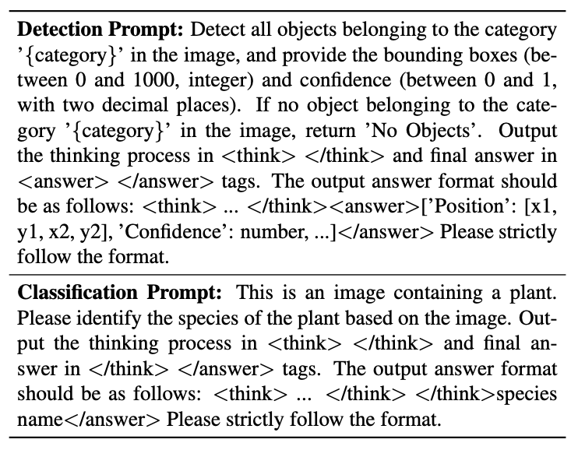
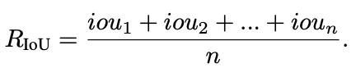
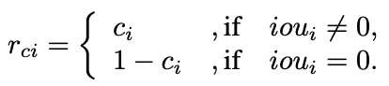
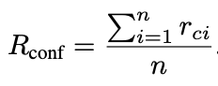
Verifiable Rewards in Visual Perception
Detection tasks:
Classification tasks:
Notes:
R_acc is simply 1 if predicted class matches ground truth and 0 otherwise

Slide 8
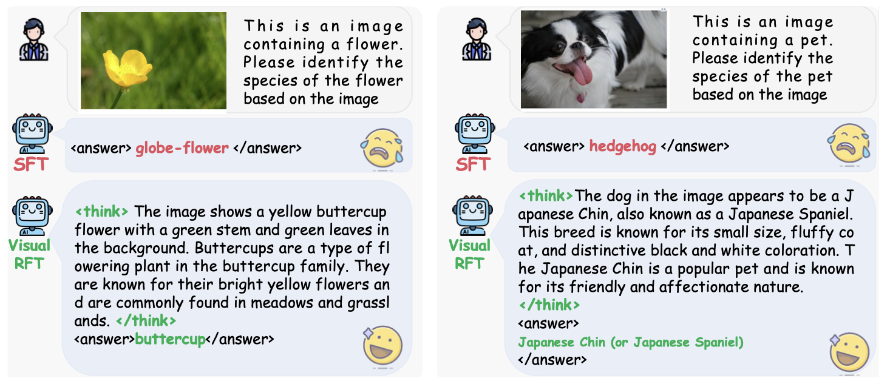
Qualitative Results Image Classification

Slide 9
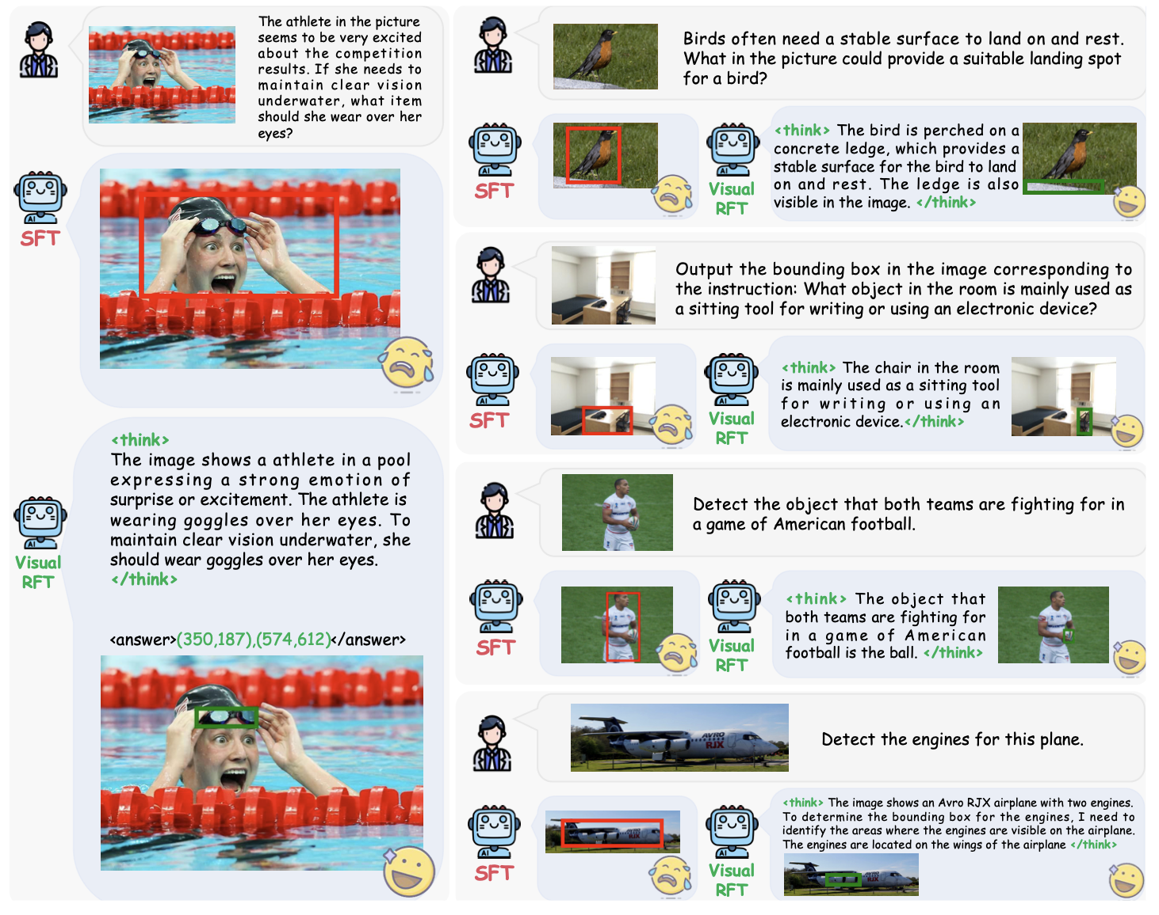
Qualitative Results Reasoning Grounding

Slide 10
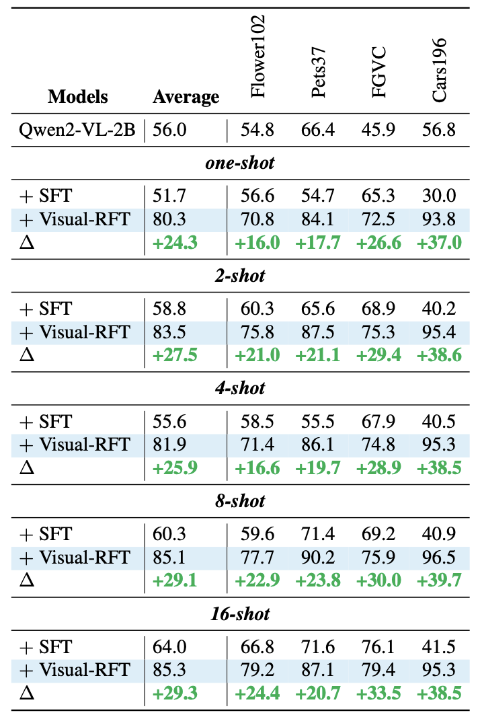
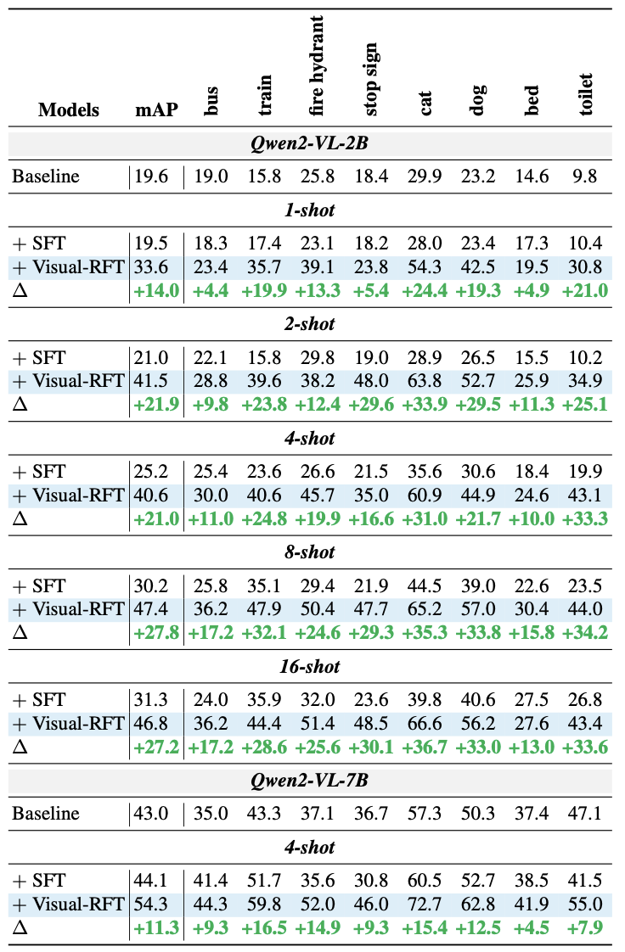
Quantitative Results
Image Classification:
Object Detection:
Notes:
IELT on Oxford Flowers: 99.64 (https://paperswithcode.com/sota/fine-grained-image-classification-on-oxford)
CO-DETR: 66.0 mAP on COCO (https://paperswithcode.com/sota/object-detection-on-coco?utm_source=chatgpt.com)

Slide 11
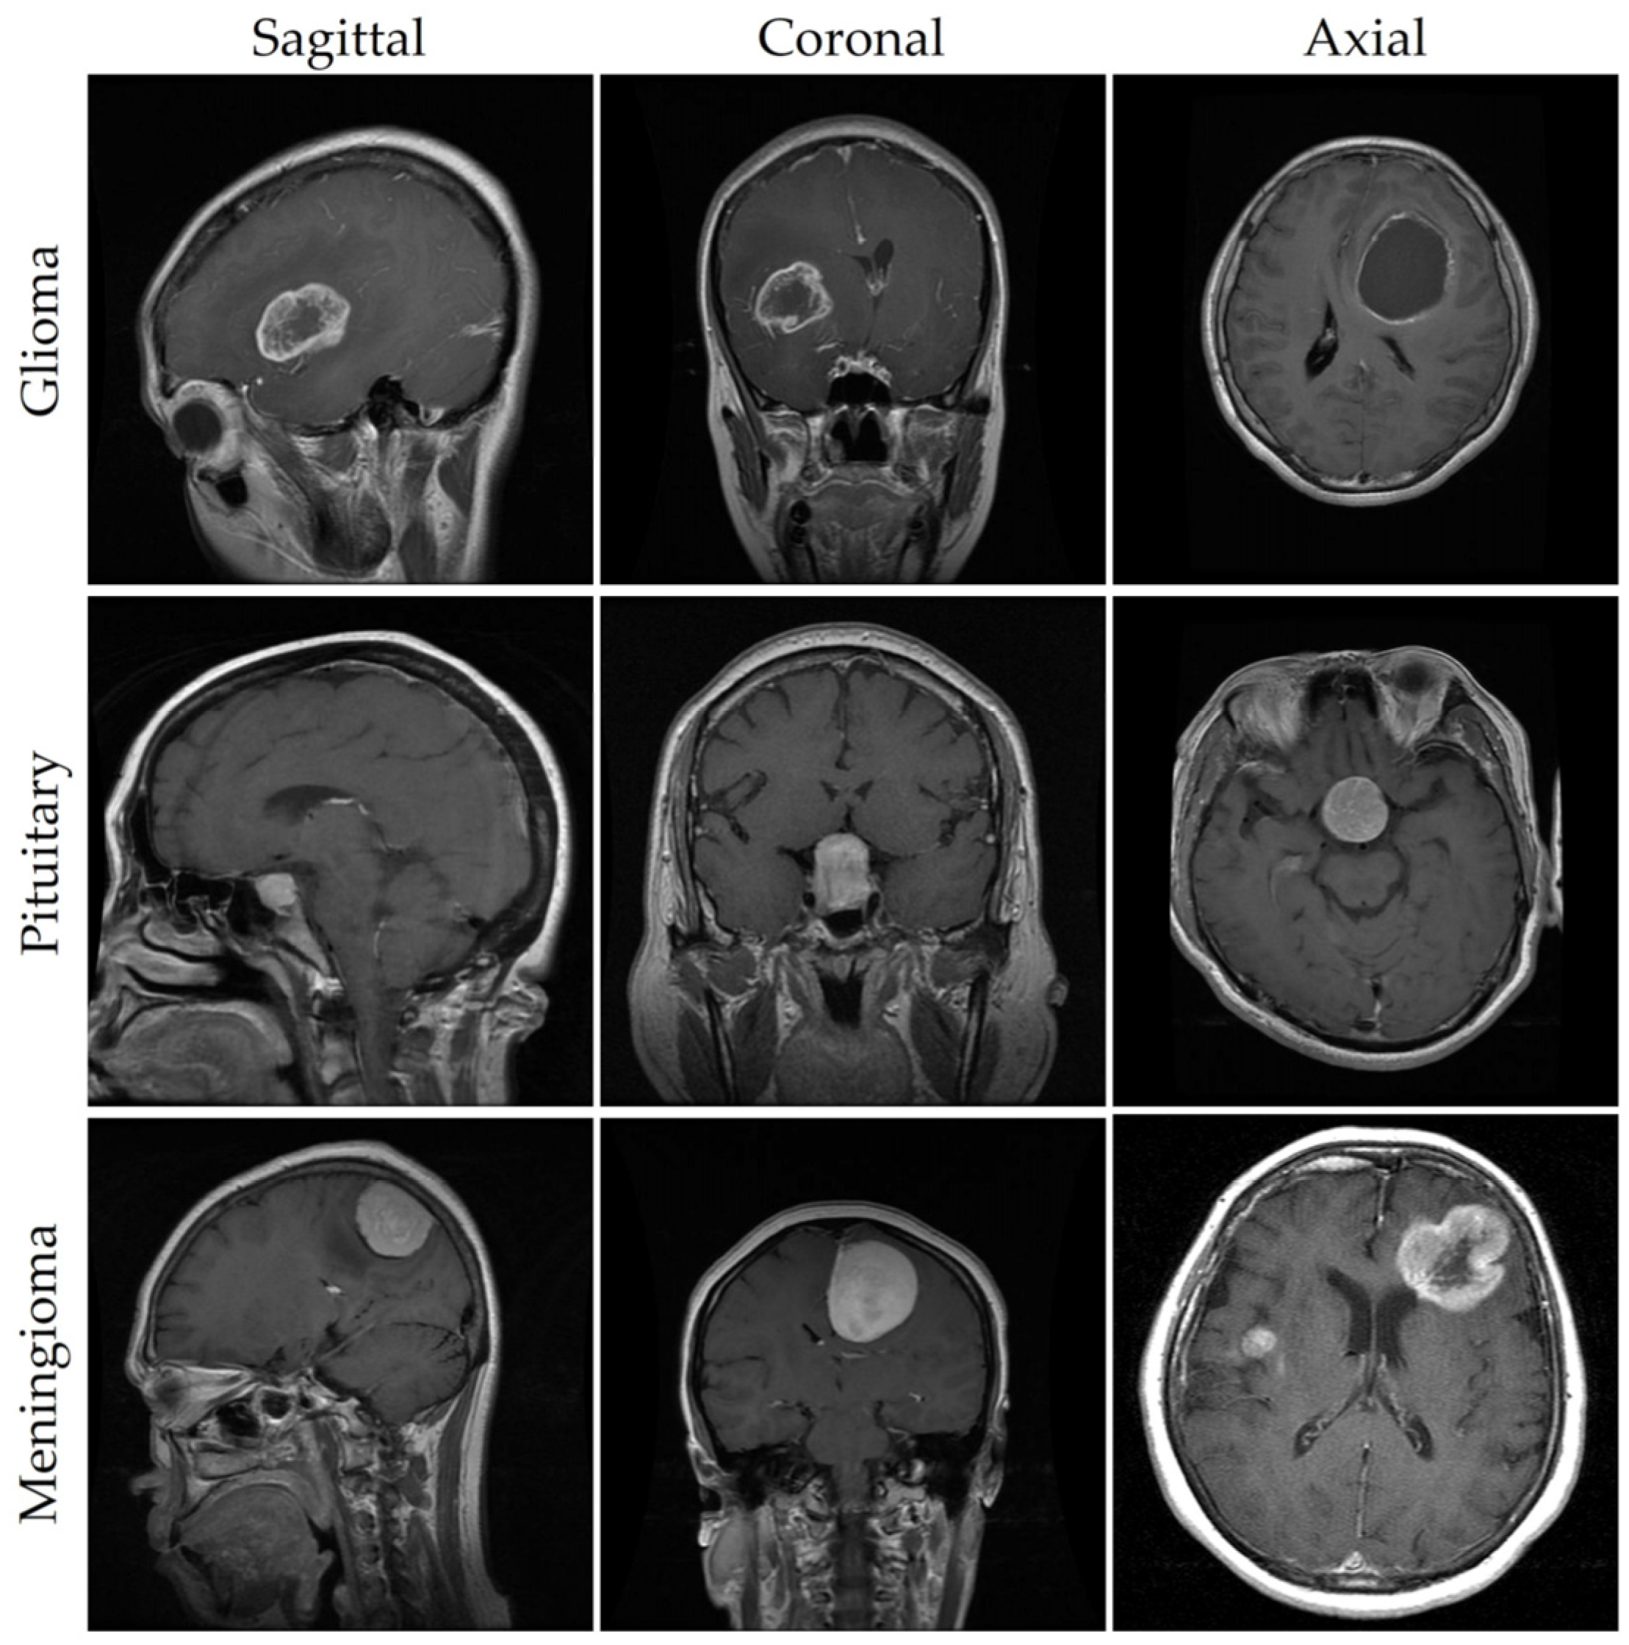
Visual-RFT in the Medical Domain ?
Medical data is often very scarce
Visual-RFT seems to perform well with limited data which suits the medical domain
Reasoning output might increase interpretability of predictions
Example: Detection of brain tumors including the reasoning process why a certain area was classified as a tumor

